Slide 1
Automated Battery Characterization
Team: sddec20-25
Advisor: Nathan Neihart
Client: Solar Car
Website: http://sddec20-25.sd.ece.iastate.edu/
Joe DeFrancisco, Ben Kenkel, Bryan Kalkhoff, Connor Luedtke, Ryan Willman, Kyle Czubak
Notes:
Kyle Czubak
Say my name
Our project is automated battery characterization. This project will be for our school’s solar car team for characterizing their batteries. Our advisor is Dr. Neihart and our members are …..

Slide 2
Problem Statement
Best performance with matched batteries
PrISUm Solar Car currently does not have an efficient way of characterizing batteries on a battery pack scale.
Currently the procedure is to measure the open circuit voltage of each battery and group them based on that measurement.
Process is time consuming on large scale (1000 or more batteries)
We will design and build an automated lithium battery characterizer
Notes:
Yo im connor
In order to get the best possible performance from a large battery pack its best to batteries matched into their modules. Iowa states solar car team does not have an efficient way to do this.

Slide 3
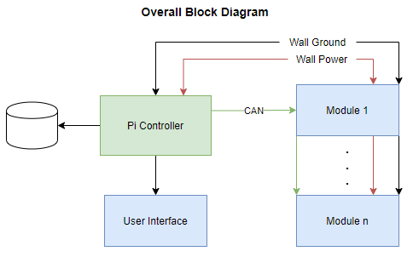
Conceptual Sketch
A Raspberry Pi is communicating with 8 battery modules and a web application
A single screen is attached to see battery test progress
3 Profiles
Charge, Discharge, and Characterization
CAN communication
Notes:
Im Ryan
On the right is the overall block diagram where there is a single raspberry pi communicating with 8 - 18650 battery modules and a web application. The user will be able to access a single screen to see the battery testing progress or switch between different battery testing modes. As solar car uses CAN communication, this is the preferred communication method.

Slide 4
Requirements
Functional
Characterize 8 lithium-ion batteries safely
Store the battery information and a way to analyze data in the future
Safely operate unsupervised
Be able to connect multiple characterizers
Non-Functional
Compute the capacity and internal resistance of each of the batteries
Batteries should not operate outside of temperature specifications as listed in JEITA guidelines
Must finish battery characterization in under 24 hours
Require minimum user interaction
Test Program
Rated Capacity
Internal Resistance
Notes:
connor

Slide 5
Technical Considerations
Measurement Accuracy
To have valid results, the voltage and current measurements will need to be accurate.
Main driver of the requirement is the internal resistance measurement, requiring µV level measurement accuracy.
Unsupervised Operation
Thermal Management
Full charge and discharge cycles will dissipate a lot of heat. This will need to be modeled so that proper heat sinking and cooling measures can be taken during design process.
Bus Load
Uses multiple buses, I²C and CAN, and needs to balance the load of both buses
Notes:
connor

Slide 6
Market Survey
The current system that solar car owns can only test 2 batteries at a time
This system will be able to test up to 8 batteries
Will be able to string multiple modules together to test more batteries at once
Custom database
Few off the shelf solutions
Notes:
Ben
This is Ben Kenkel talking about our potential market. PrISUm does own a battery tester that is capable of testing two batteries at a time, but it would take a very significant amount of time to test all one-thousand batteries that would be going into a battery pack, making it largely unfeasible to use. This results in the team using simpler, less-effective, manual tests to find rough baselines for the batteries. The current tester also doesn’t allow the team to export any data, and is generally not a tool that the team prefers to use. The team wants a better characterizing method, but has found that very few off the shelf solutions exist, and that the few that do are typically not as feature rich as desired and tend to be fairly expensive, which had led us to design a system that will better suit PrISUm’s needs.

Slide 7
Potential Risks & Mitigation
Lithium ion batteries are very sensitive to temperature and can be prone to thermal events ( ie exploding).
To limit potential thermal events both hardware and software measures are being used
The charging circuit follows JEITA standards and has a thermal shutdown if battery temperature exceeds 60 degrees celsius.
There is short circuit protection and fusing if a battery is put in backwards or if a large current draw occurs.
Finally, we have extra temperature measurement circuitry and software shut offs in place.
During testing we will have appropriate equipment including fire extinguishers and buckets of sand available in case of any problems.
Notes:
Ben
There are a couple risks to be aware of when designing a system to work with Lithium Ion batteries. As you may be aware, lithium ion can be a bit picky about it’s operating conditions and tend to react by igniting on fire. We will be using protection in both hardware and software to monitor the batteries at all times, and react in the event on any issues. For example, our charging circuit follows JEITA standards and has a built in shutdown if the battery exceeds 60 degrees celsius. We also have hardware protection for batteries being put in upside-down and large current draws. Of course, the batteries would be most likely to display any issues during testing, where our software can adjust and respond to declining conditions before our hard limits take effect. We have talked with Iowa State Universities Environmental Health and Safety about best ways to handle problematic batteries, including isolating the batteries in buckets of sand and the proper disposal methods for damaged cells.

Slide 8
Cost Estimate
Potential Costs
Raspberry PI & Screen -$100
Parts - $180
PCB - $50
Total ~$350
Notes:
I’m Ryan
Listed are the potential costs of the project. The hardware for software implementation is a raspberry pi and screen which is around $100. Components to assemble the PCB and create the finalized design total to about $230. Batteries are not included in the costs as they are provided by the client. This allows the project to total to no more than $350 in costs, which is well under the $500 maximum ,allowing for a buffer if unexpected costs occur next semester.

Slide 9
Project Milestones
Hardware:
Complete design of following circuits:
Charging
Load
Measurement
Microcontroller
Model Overall Thermal Dissipation Requirements
PCB Layout
Software:
Flask app setup and running
Including database
HTML and CSS for frontend
Microcontroller communicating with ICs and app
Notes:
Kyle
Our project milestones for hardware include completing a design schematics of our charging, load, measurement and microcontroller circuits. Model overall thermal dissipation to make sure the batteries stay at a reasonable temperature. And Finally create a PCB layout with all of our circuits. For software our milestones was to get our web backend running using flask with HTLM and CSS as a frontend and being able to store and query data from a database. Also we wanted to have our microcontroller to communicate with the ICs through I2C and with our app through CAN.

Slide 10
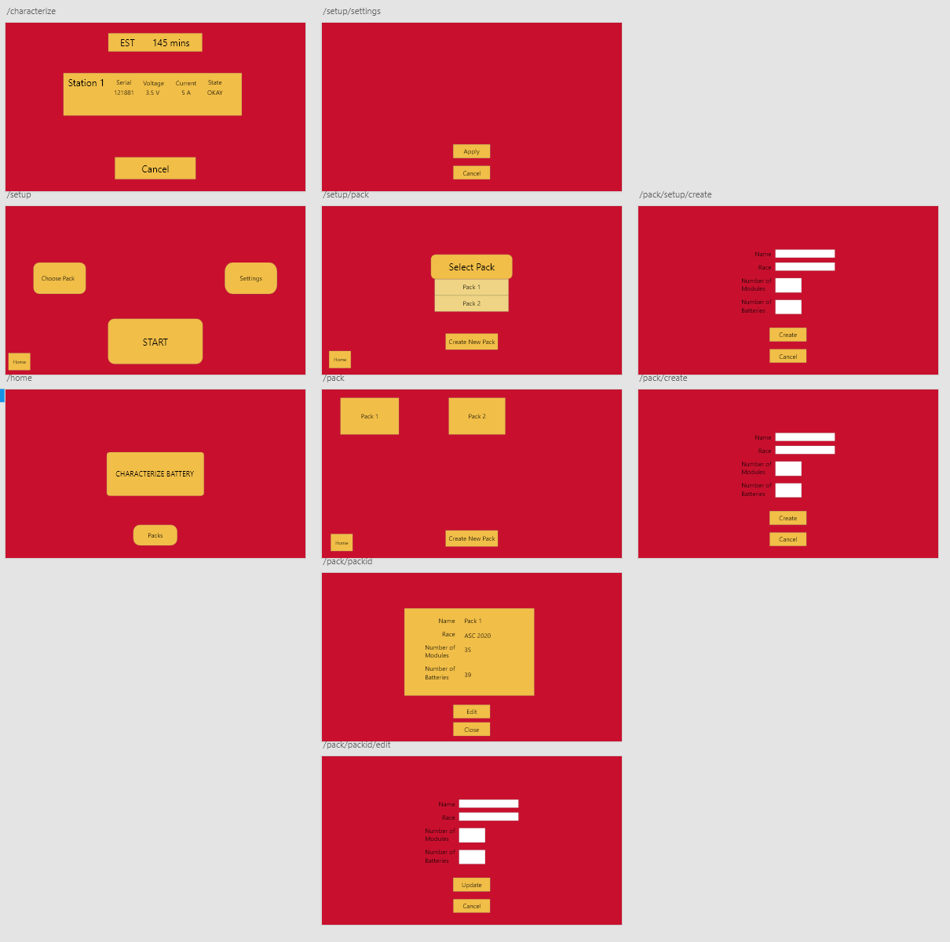
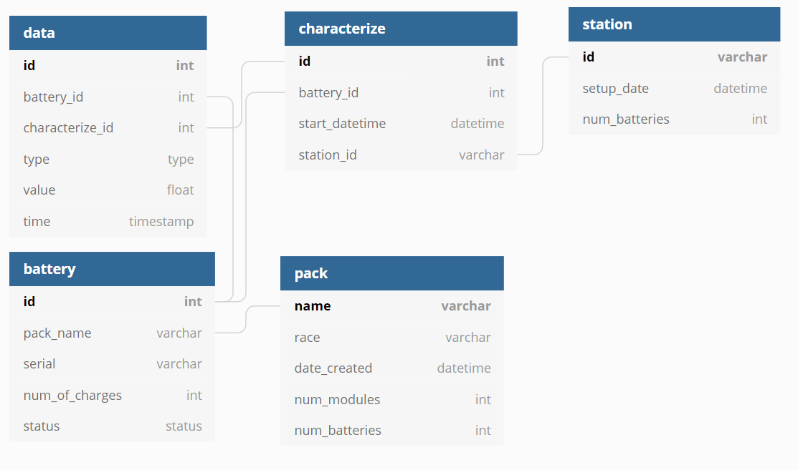
Web App
Web App
Flask, HTML, CSS
Raspberry Pi
Web backend
Touch screen display
Interact with user and hardware
Start battery testing
Monitor the process
Look up batteries
Create packs
Notes:
Kyle Czubak
We decided to use a web app for our graphical user interface. We decided on this because we have experience using flask and using a web app can easily communicate with a database which is a requirement. Also we want to use a touchscreen display for the GUI so the user can interact with our app easily and efficiently and our web app will work well with the touch screen. Our app will be communicating with the characterizers through CAN to get the information from them. Since we will be using a touch screen, web app, database and CAN network, the best device that can do all of this is a raspberry pi. The raspberry pi will host the web app and database while also communicating with the battery characterizers through CAN with a CAN hat.
For the app, first and foremost we want the user to be able to start the characterization process and then be able to monitor the process when it is running. The user will be able to see every battery with their serial number, current, voltage and status. The user will also be able to stop the process if something goes wrong or if the user wants to restart it. After the process has been finished, the user can look up the data from batteries that has already been characterized and the data will be presented in graphs and other useful ways.

Slide 11
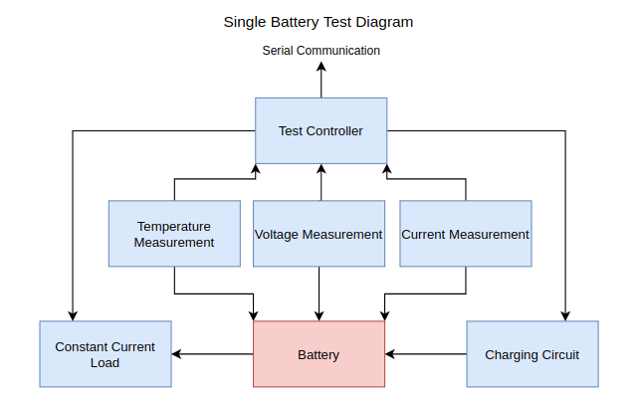
Hardware-summary
Using Altium for schematic and PCB layout
Project was broken down into several groups
Power, microcontroller, charge, and discharge
Will communicate with PI using CAN
CAN is fast enough and have experience
Will use I²C to communicate with microcontroller and other IC
Notes:
Hi I’m Bryan Kalkhoff: For our hardware design, we chose to use Altium for creating the schematics and eventually the pcb layout. We chose Altium because majority of the group has experience using it, and because the school has licences that we can use. As for the hardware itself, we broke the project up into 4 groups. Power, microcontroller, charge and discharge circuits with Power being simply how we will be powering the circuit. The other three will be discussed later. For communication between the pi and the modules, we will be using CAN. This decision was made because again, majority of the team has experience using it and CAN can transmit data at a high enough rate. Finally communication between ICs will be done through an I2C bus.

Slide 12
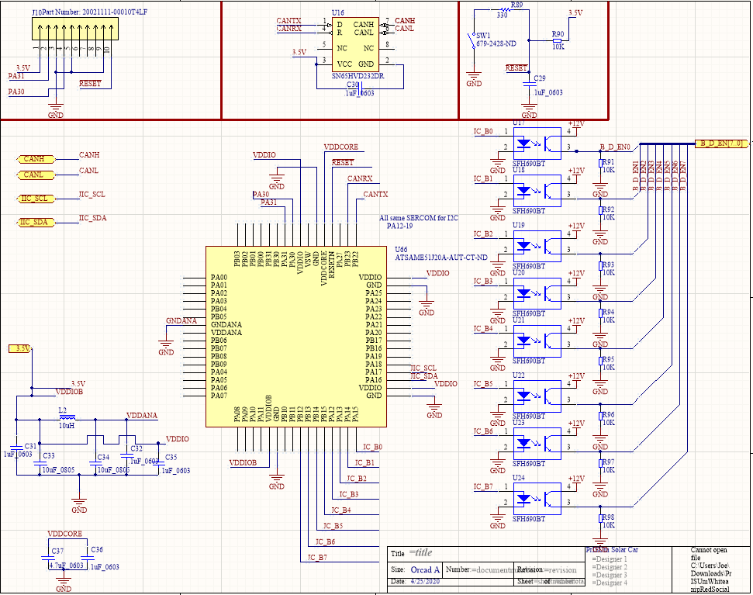
Hardware - microcontroller
Using ATSAME51J20A-AUT microcontroller
Part of Atmel’s “connection” family
2 CAN
Several I²C ports
Potentially need more than 1 due to addressing problems
Optoisolators are used for a buffer
Signals go to relays
Plan on having LEDs for debugging and visual indicators
Notes:
The microcontroller that we include on the module will need to be able to handle, communication with the pi, communication will all the measuring circuits, and running basic calculations based off the information given. To accomplish this, we chose the Atmel ATSAME51J. We went with this microcontroller because it was a part of Atmel’s “connection” family. This particular chip has 2 CAN ports, several I2C ports, and 1 MB of program memory. This will allow us to write code without worrying about memory space or ports problems. Along with using some optoisolators, this chip will be able to control majority of the functions needed for our project. For the microcontroller to be able to use CAN, it needs a CAN transceiver. For this, we chose TI’s transceiver.

Slide 13
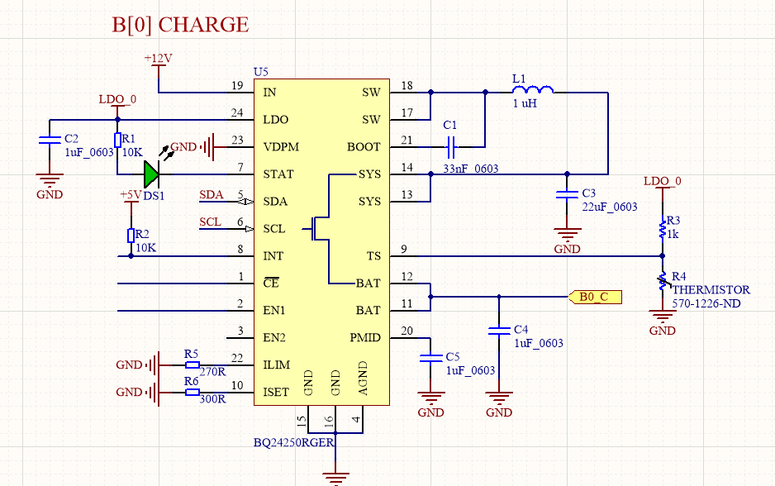
Hardware- charge circuit
Chose TI BQ2425x
Constant charge IC
Self regulating
Will know when the batteries are charged
Communicates to microcontroller via I²C
Thermal shutdown
Programmable charge voltage and current
Will help with characterizing batteries
Notes:
We knew that we would need to either create a circuit that could safely charge the batteries, or find an IC to do it. Luckily we were able to find an IC. The TI BQ2425x was chosen because of some key features. This includes: programmable charge voltage and current, temperature monitoring, I2C communication, thermal shutdown, and indicator. Through the microcontroller, we will be able to enable the IC, thus giving us more control over the charging portion of the test. The IC also will be able to monitor if the battery is fully charge, this will reduce the amount of parts needed (compared to designing our own circuit). Our plan is to have 8 of these all working at once to charge the batteries at a safe rate.

Slide 14
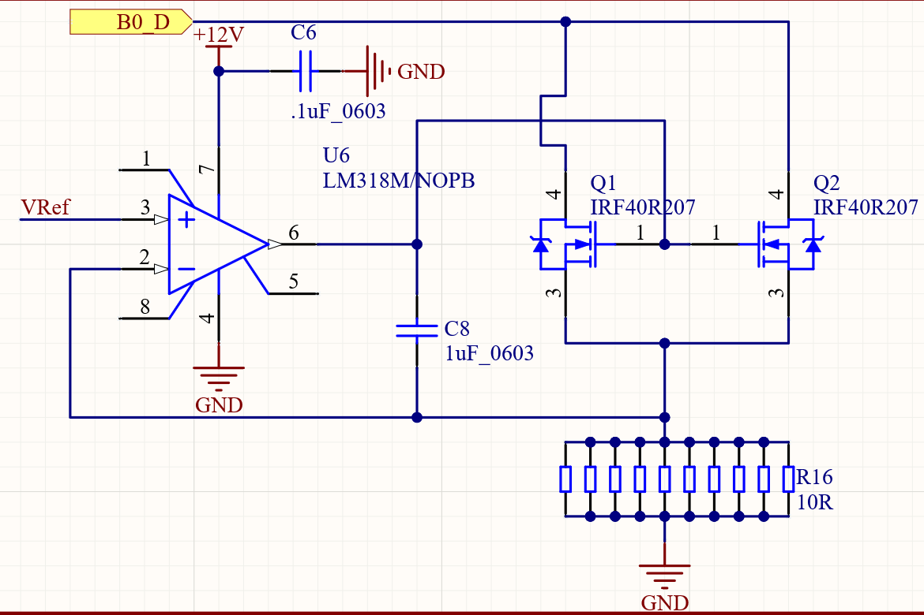
Hardware - Constant Current Load
An active circuit is required to discharge batteries at constant current across entire voltage range.
Vref is generated by a precision voltage reference and digital potentiometer.
C8 is now 2.2uF
Requirements:
Programmable current from 0-3.3A
Capable of dissipating 4.3W continuous(worst case).
Stable with minimal overshoot.
EEVBlog Video:
https://www.youtube.com/watch?v=8xX2SVcItOA&t=111s
Notes:
Hello my name is Joe DeFrancisco. The design for the constant current load circuit is based on an EEVblog video linked in the slide. The purpose of this circuit is to provide a constant current discharge of the battery. A simple resistor will not provide the necessary performance because of several reasons. First, the battery voltage swings from 4.2V to 2.8V in a full discharge cycle. A passive resistor would not pull a constant current due to the changing voltage. Second, a resistor would not be programmable to any load current we need. This circuit uses a TI LM318 op-amp along with two Infineon NMOS transistors to regulate the current. We would like to avoid heatsinks as much as possible, but we may need one here due to the high ambient temperature these devices will be operating in. The resistors at the bottom of the page are each 1% 10ohm 1W rated resistors. We chose to use this method because 1% tolerance 1Ohm resistors are expensive along with the need for high power ratings. By using 10 resistors we can relax the power rating requirements for any individual resistor, and 1% 10 Ohm resistors are cheap and plentiful.
The load current is set by the voltage at the pin 3 of the opamp, labeled VRef. The op-amp will modulate the gate of Q1 and Q2 to ensure that the voltage on pin 2 is equal to VRef. The 10 resistors at the bottom of the page will form an effective 1 ohm resistor. Having the 1 ohm resistor will translate the value of VRef into current. For example if VRef is 1.5V, then the load current being pulled from the battery is 1.5A.
A concern with this circuit is stability. Capacitor C8 will slow the system response down and reduce the open loop gain. There is a lot of flexibility with the value of this capacitor, the minimum value for stability is about 500nF. Thermal stability is more difficult to model, and we will be doing extensive testing once we have hardware.

Slide 15
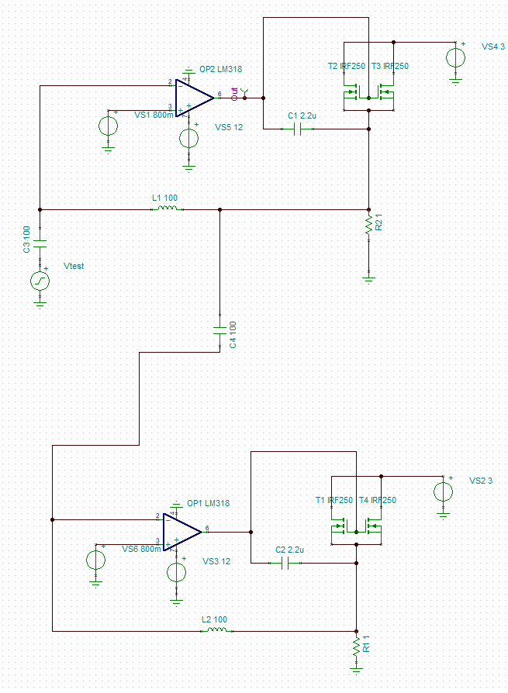
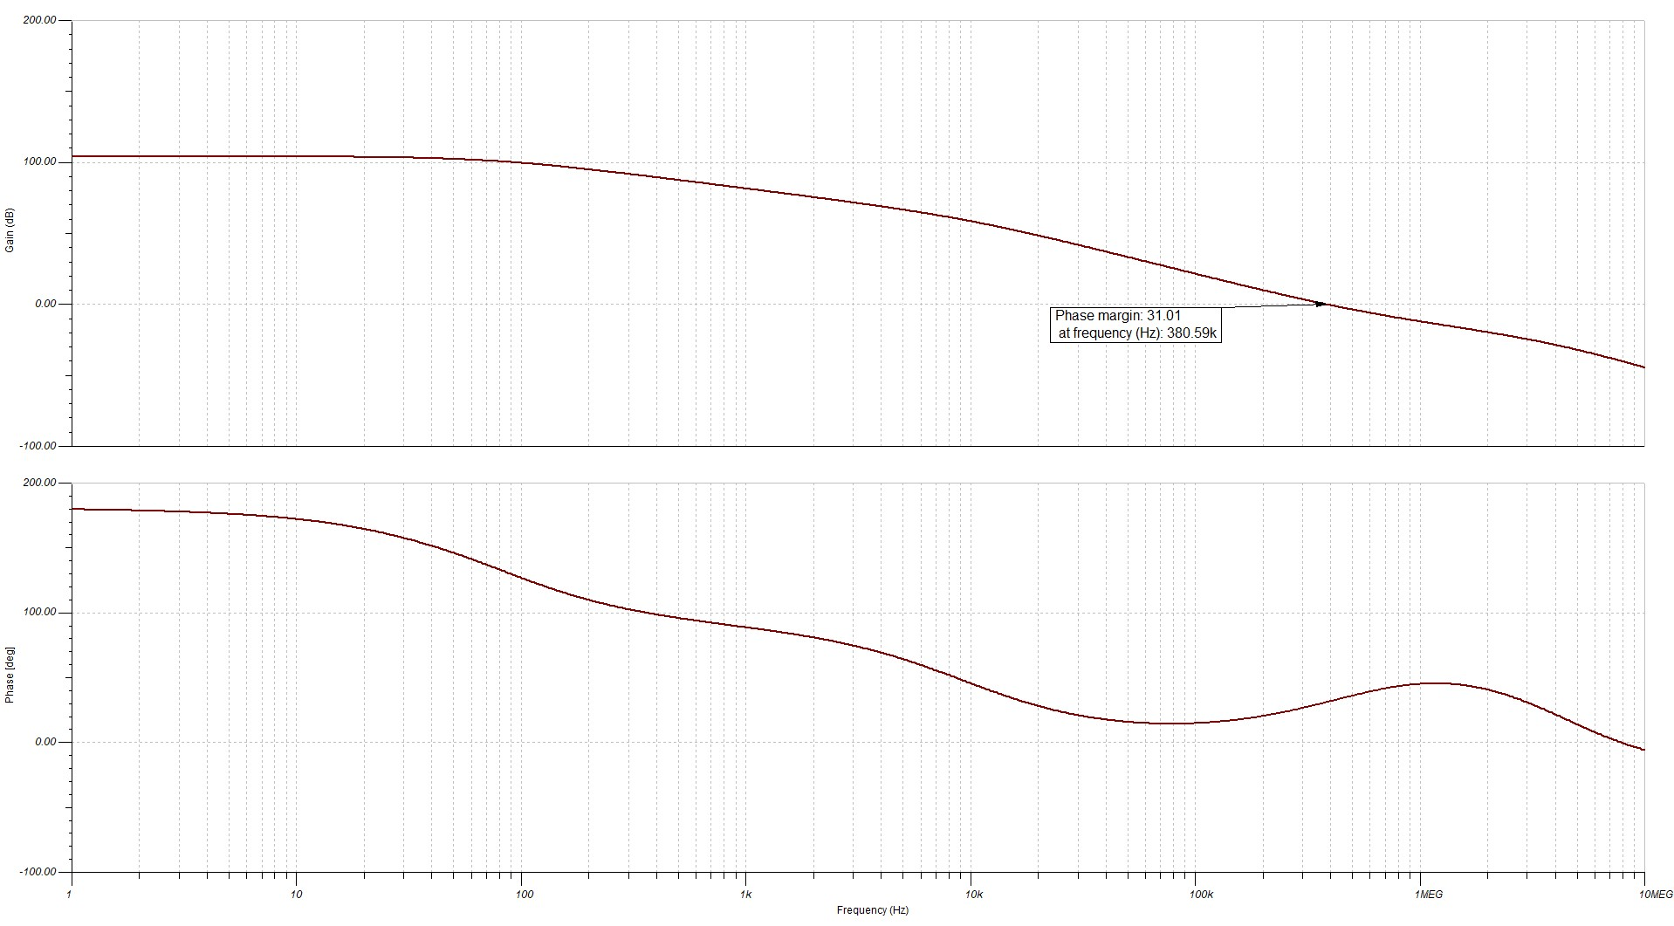
Hardware - Constant Current Load Stability
Notes on Stability Analysis:
https://www.allaboutcircuits.com/technical-articles/negative-feedback-part-9-breaking-the-loop/
Notes:
Joe
Joe again. To check the stability of this circuit, we set up the above simulation in TINA-TI Spice simulator. We were able to find a spice model for the LM318 op-amp and used a MOSFET from the same transistor family. The magnitude and phase of the top op-amp output is plotted on a log frequency scale. The feedback loop is broken and a dummy load is put in place. Large capacitors and inductors are used to allow AC interaction while maintaining DC biasing conditions between the two circuits. This AC simulation sweeps from 10Hz to 10MHz and is intended to measure open loop gain so that we can find the phase margin of the system.
The measured phase margin is 31.01 degrees at 380kHz. This should leave enough of a stability guardband while allowing the system to respond quickly. The value of the feedback capacitor can be made larger to increase the phase margin.
A transient simulation was also run where the load current is pulsed by a 10kHz square wave reference voltage with nanosecond rise and fall times. The overshoot was approximately 6mA and settled in approximately 100us.

Slide 16
Current Status
Test Plans for battery characterization
Hardware Schematics
Measurement
Load
Charge
Microcontroller
Web app backend and database
Notes:
Im Ryan
Currently, we have test plans to characterize a battery. The hardware team has finished schematics for the measurement, load, charge, and microcontroller designs. The software team has developed the backend and database for the web application.

Slide 17
Task Responsibility
Joe DeFrancisco
Battery Test Program Outline
Measurement and load circuit design
Bryan Kalkhoff
Embedded hardware design: choosing microcontroller
Ryan Willman
Thermal Circuit design
Connor Luedtke
Power circuit and charging structure
Ben Kenkel
CAN termination and CAN database
Kyle Czubak
Web backend app and database
Notes:
Ben
This is Ben again talking about our task responsibility. Joe DeFrancisco has been responsible for our battery test program outline as well as our measurement and load circuit designs. Bryan Kalkhoff has been responsible for the hardware design regarding our microcontroller. Ryan Willman is responsible for the thermal monitoring circuit design. Connor Luedtke has been creating the power and charging circuit designs. I have been responsible for our automatic CAN termination plan and the design of our communication protocols. Kyle Czubak has been working on the design of our user interface as well as the database for storing test data.

Slide 18
Hardware/Software-future plans
PCB layout
Compact design
Enclosure Design
Test Hardware
Test Hardware and Software interaction
Communicate between modules and app
Notes:
Joe
For next semester, the team plans to design and fabricate a functional PCB, make sure the design is as compact as possible, validate the design through software and hardware measures, implement multiple battery modules, and allow the design to communicate with the web app and all modules.

